Slide 1
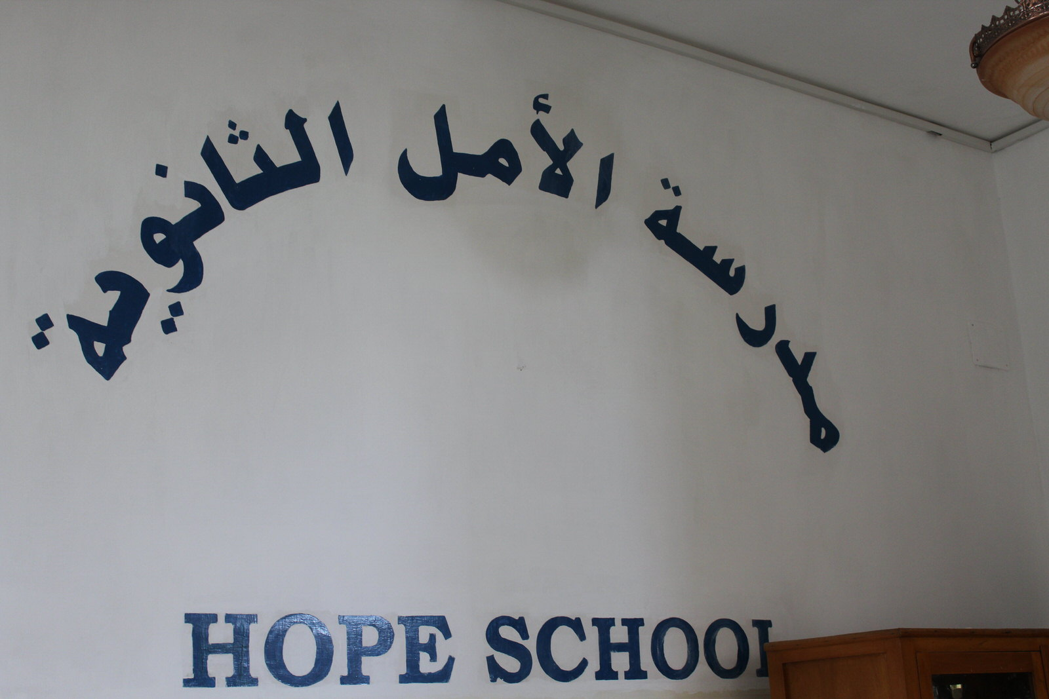
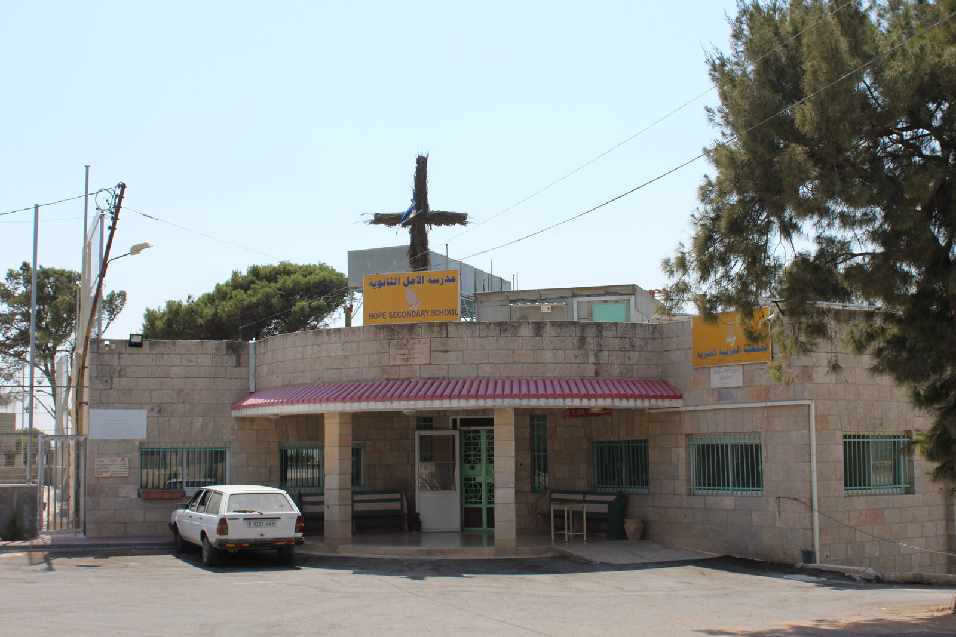
Welcome to Hope School, a beacon of Christian education for needy students in the Greater Bethlehem area.
Since its beginning, the school has maintained its goal of offering a second chance to students who failed to succeed elsewhere, either because of financial, psycho-social, or academic difficulties.

Slide 2
Hope By The Numbers
Grade | KG | 7 | 8 | 9 | 10 | 11 Literary | 12 Literary | Total | Teachers 15/ Staff 10
Christian/Moslem | 6/8 | 2/6 | 10/17 | 17/7 | 13/5 | 6/5 | 8/11 | 62/59 | 22/3
Day/Boarding | 14/0 | 7/1 | 24/3 | 20/4 | 17/1 | 11/0 | 17/2 | 110/11 | 24/1
Male/Female | 9/5 | 2/6 | 22/5 | 15/9 | 13/5 | 7/4 | 16/3 | 84/37 | 13/12
Returning/New | 0/14 | 0/8 | 12/15 | 22/2 | 11/7 | 8/3 | 13/6 | 66/55 | 20/5
Total | 14 | 8 | 27 | 24 | 18 | 11 | 19 | 121 | 25

Slide 3
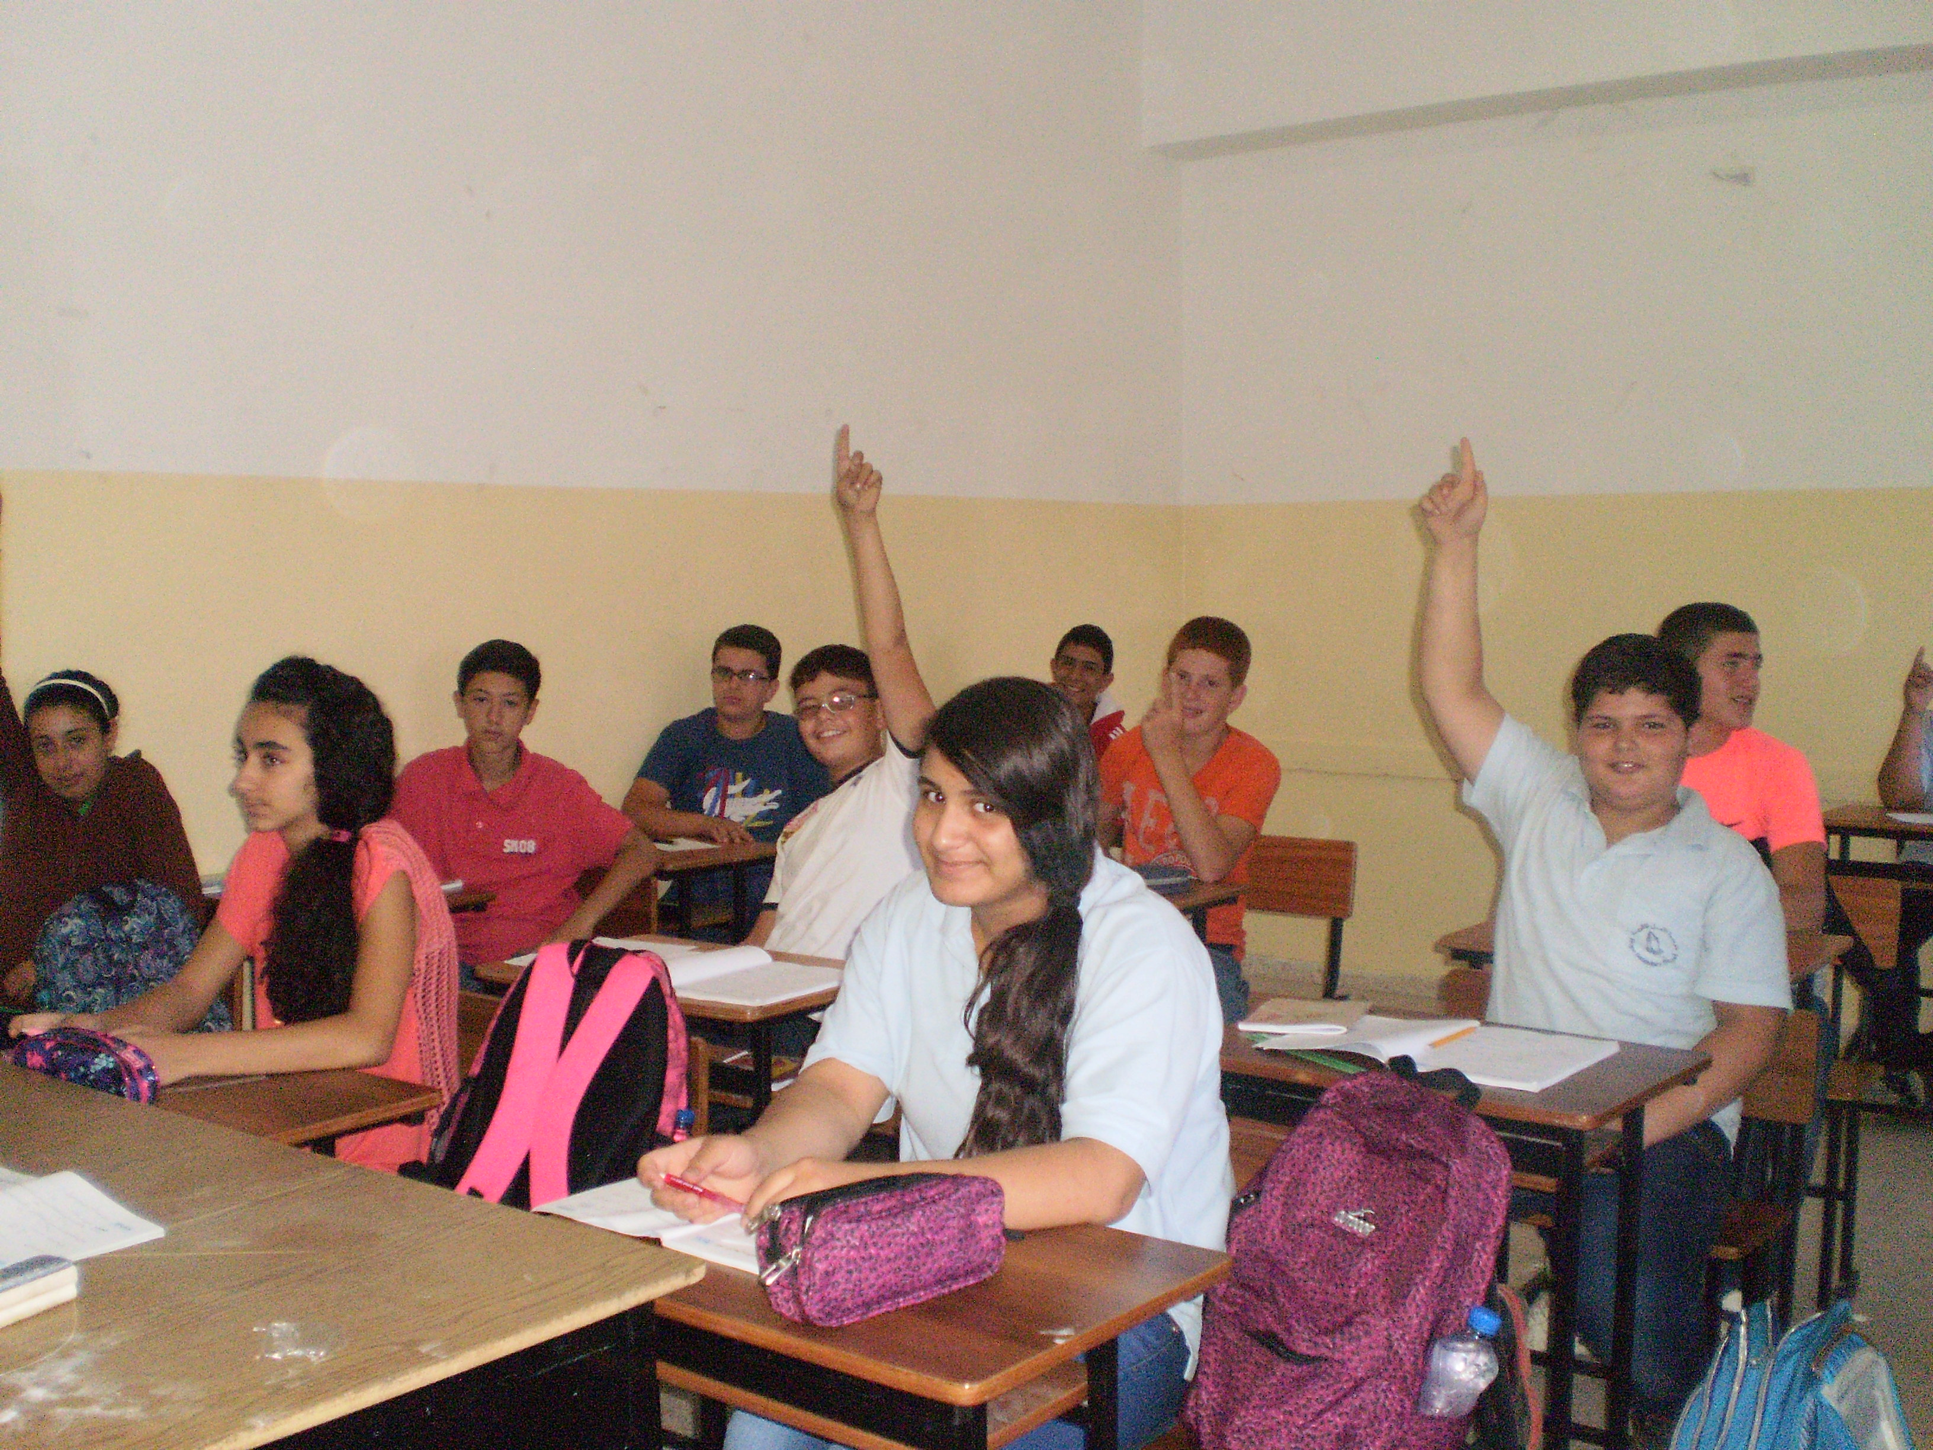
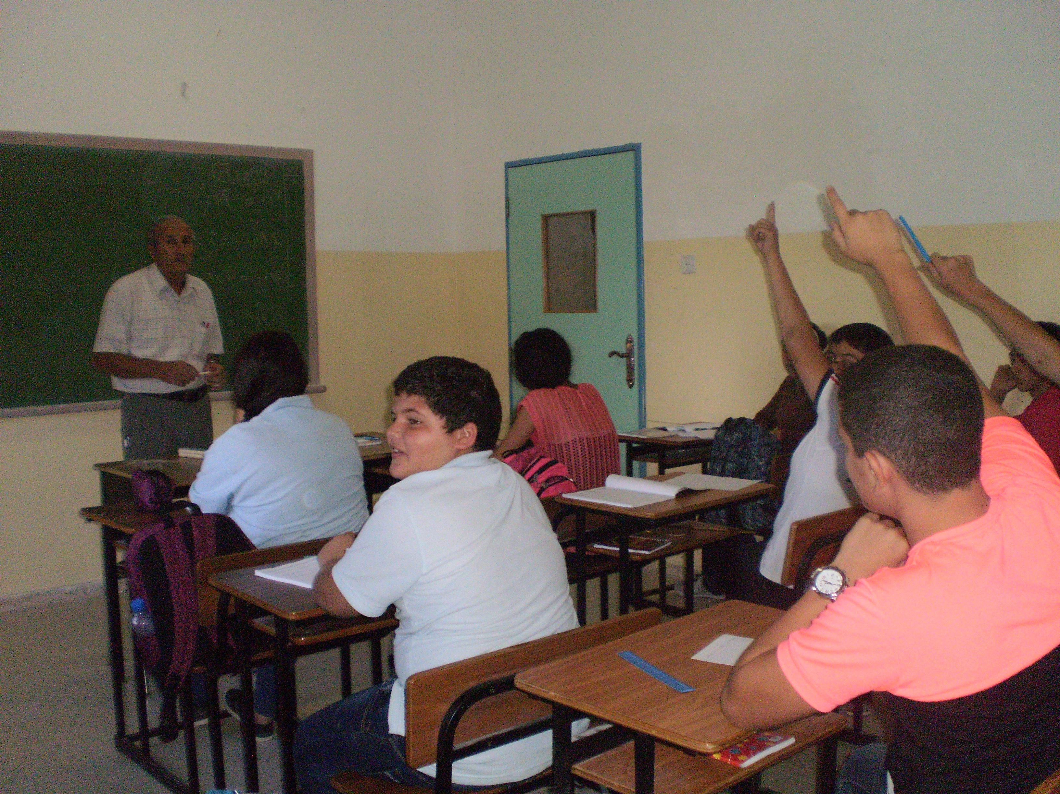
Hope School is currently experiencing a resurgence. The past three years have seen an increase in finances and new projects begun, but most importantly, student life has greatly improved.
At its nadir, Hope School was only taking in only 65 students. This school year we are proud to welcome around 125 students!
Academically, the tawjihi (graduate) exam was formerly a point of weakness; the passing rate at one point was only 15%. Last school year, 100% of the students passed!

Slide 4
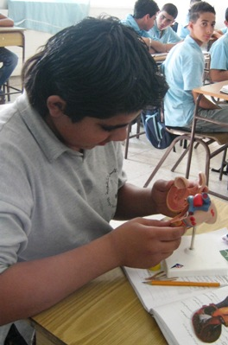
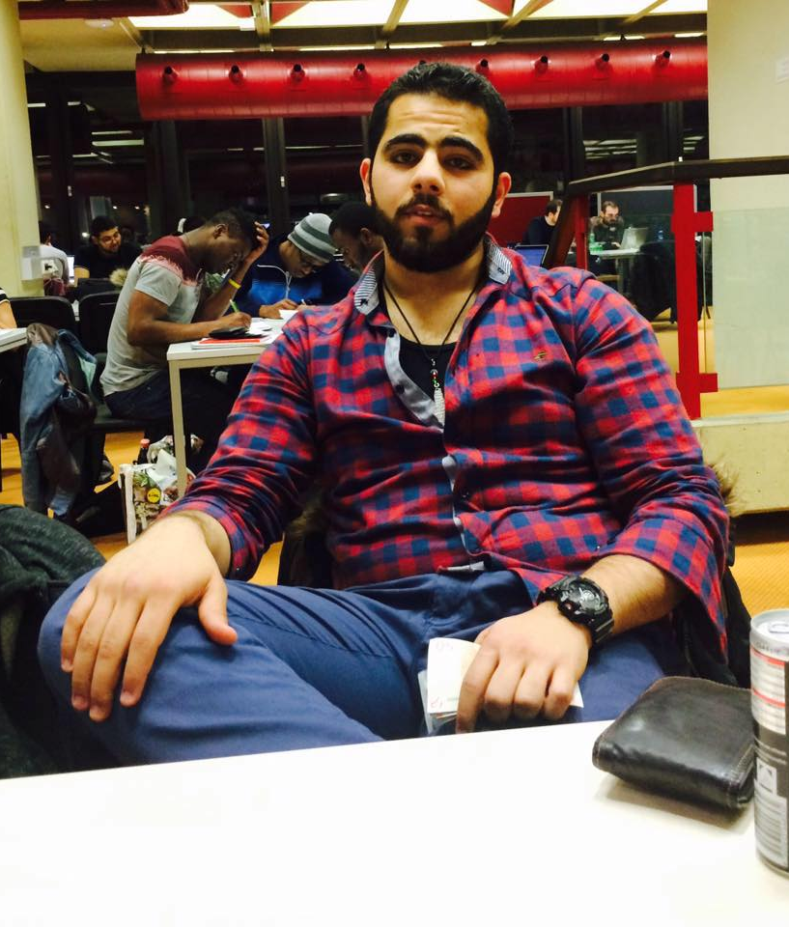
Success Story: Sharaf
Sharaf Abu Ali graduated from Hope School two years ago. Joining Hope School at age eleven, Sharaf was raised on Christian teachings every day through the school chapels. Sharaf’s parents are farmers and had plans for him to leave school and take care of the sheep. Sharaf knew about Hope School from passing by it while going from his nearby village to the city. He was determined to join Hope School, and the school administration helped in convincing his parents that the school could offer him a better future. Sharaf remained at Hope School and graduated with high marks. He is now studying electrical engineering in Germany and visits the school every time he returns to visit his family.
Top photo: Sharaf as a student at Hope.
Bottom: A picture of Sharaf at university in Germany.

Slide 5
Success Story: Samar
Samar Rabie graduated from Hope School in 2002. She came from a family that struggled financially. Her father is a painter and the only provider for the family. Samar, despite of all the financial hardships at home, was determined to join Hope School and complete her secondary education. Hope School staff made this a reality for her and eased her financial burdens by finding a good sponsor to help her with her studies. The school also provided her with clothes, studying materials, and food every school day. Today, Samar is an employee at Hope School as the assistant of the kindergarten. Samer says, “Without joining Hope School I would be nothing. Hope School has taught me everything, and the faith Hope School shares with its students helps them to set a goal in life and be successful in their futures.”

Slide 6
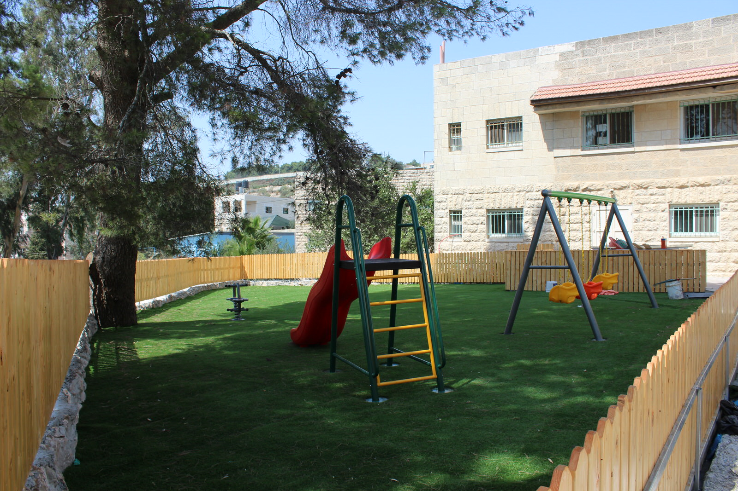
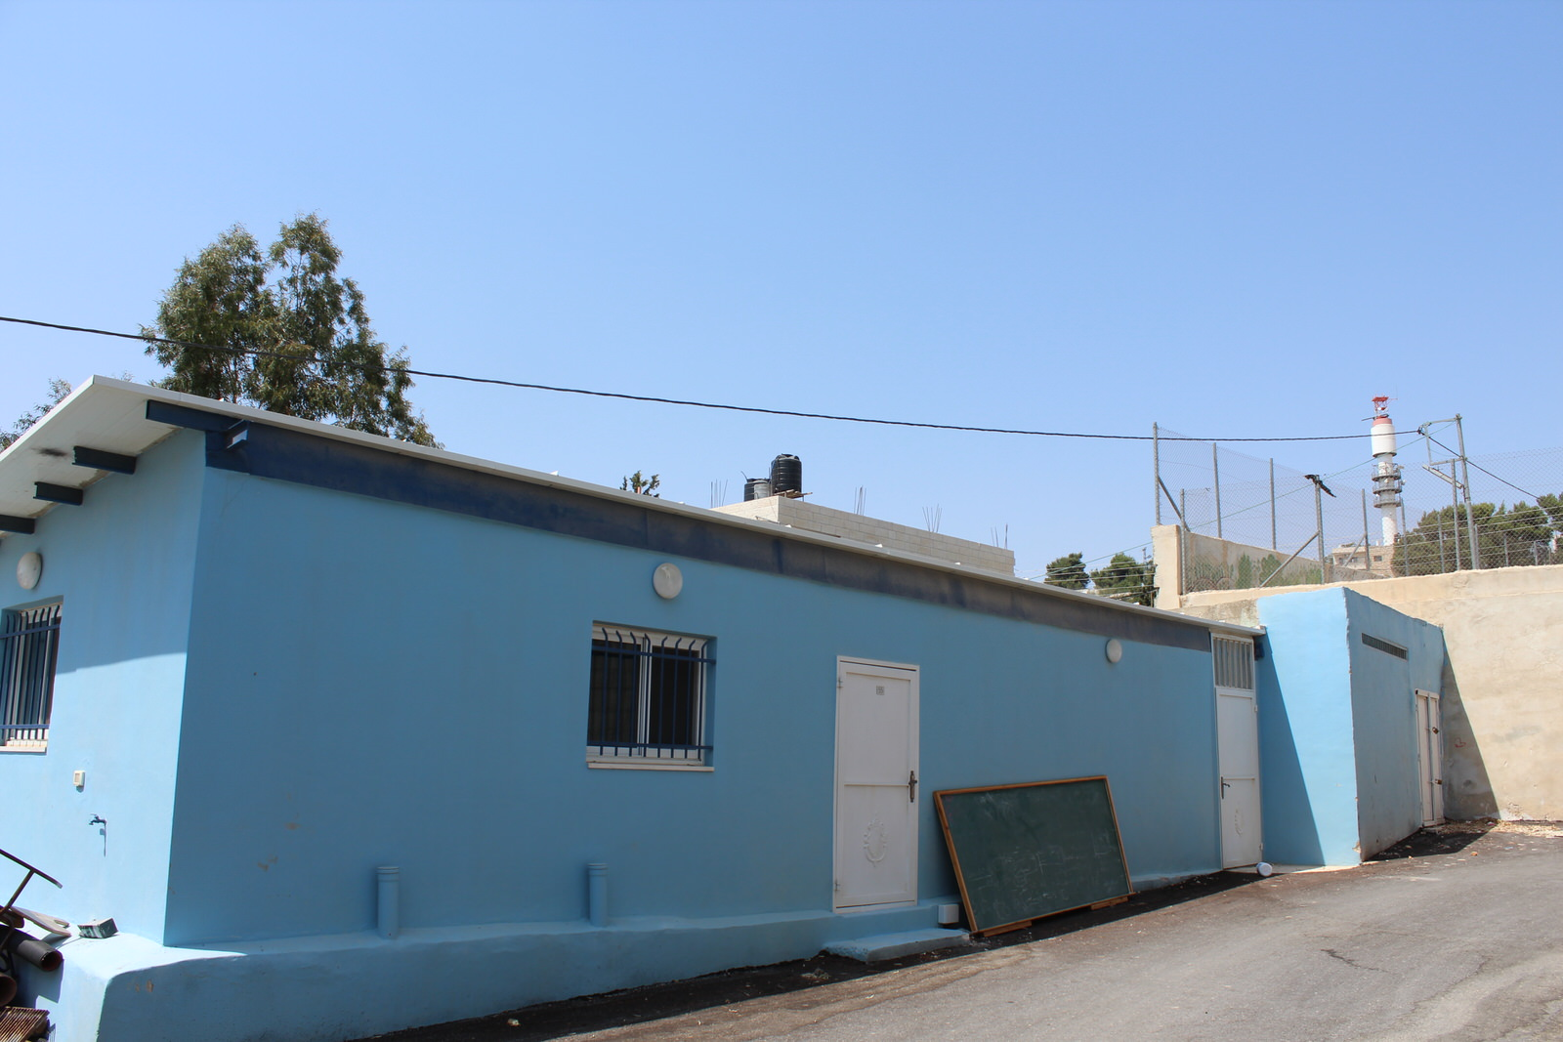
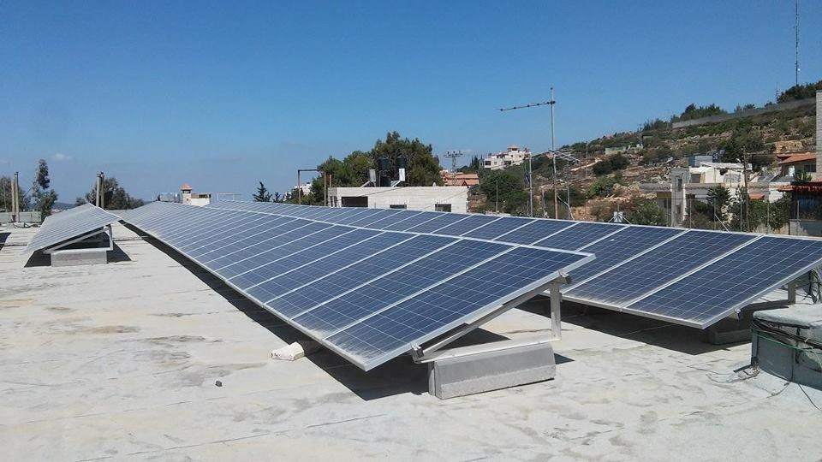
Here are three of the projects completed over the past year: a new laundry room annex which allows for more classroom spaces, solar panels that fully supply electricity for the school, and a playground for our incoming class of kindergartners.

Slide 7
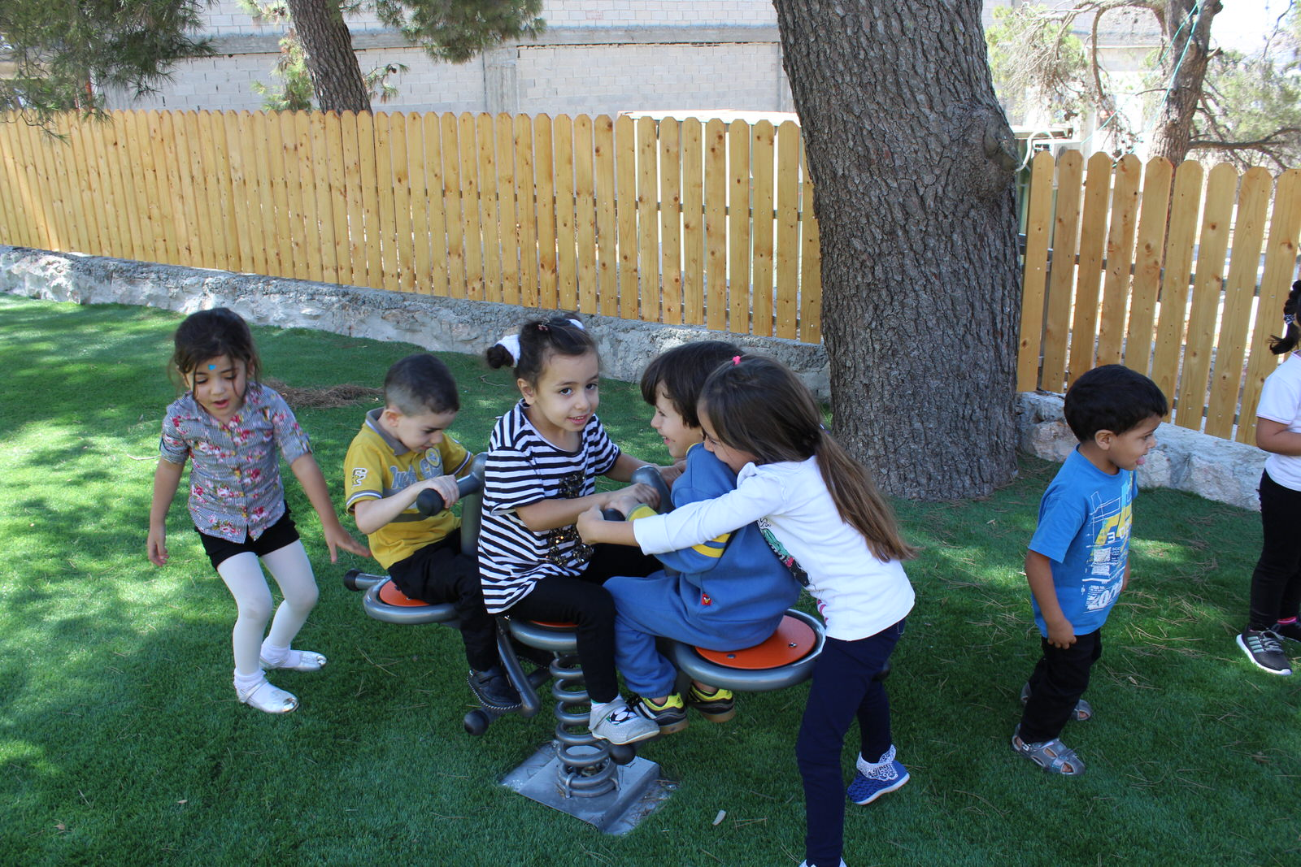
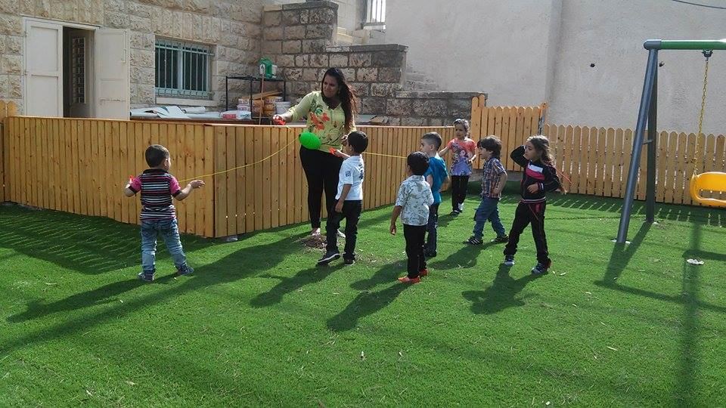
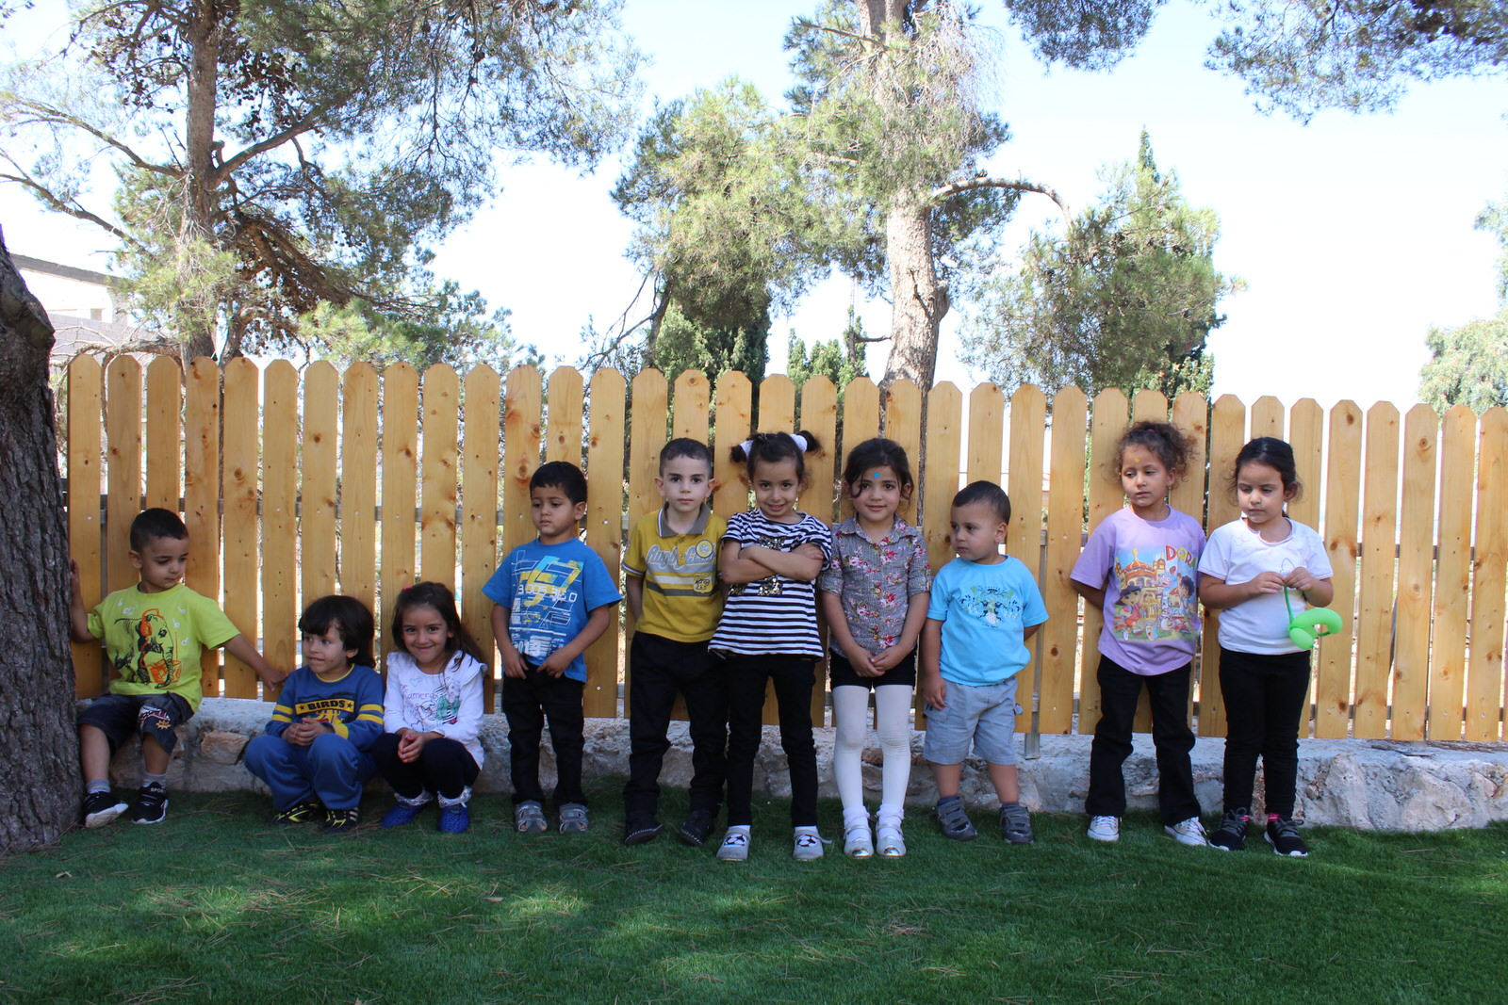
Hope School had previously been only for secondary students, grade 7-12. This year, however, we are beginning a kindergarten program, with the intention of continually adding a class each year until we are a full K-12 school. We are very excited to have these young ones with us!

Slide 8
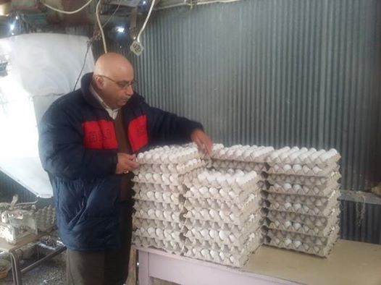
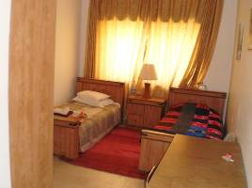
Hope has also restarted its chicken farm. At its peak, the farm could hold 7,500 chickens, whose eggs at one time brought in 20% of the school’s income. After being completely emptied, the farm now holds around 3,500 chickens, and the school is hoping to increase this number in the coming year.
Our school holds several rooms for guests. We love to have visitors, and for that reason we open our guest rooms free of charge.
Chicken Project
Guest Room

Slide 9
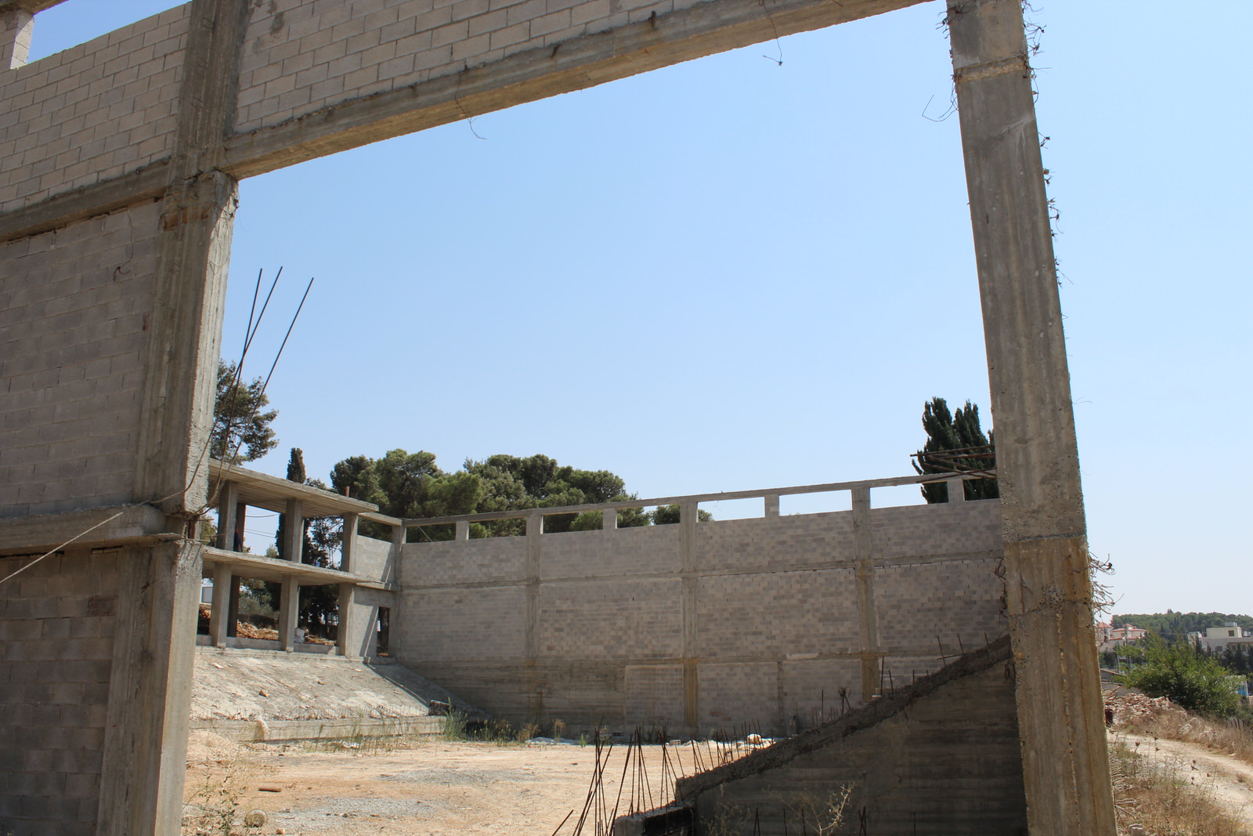
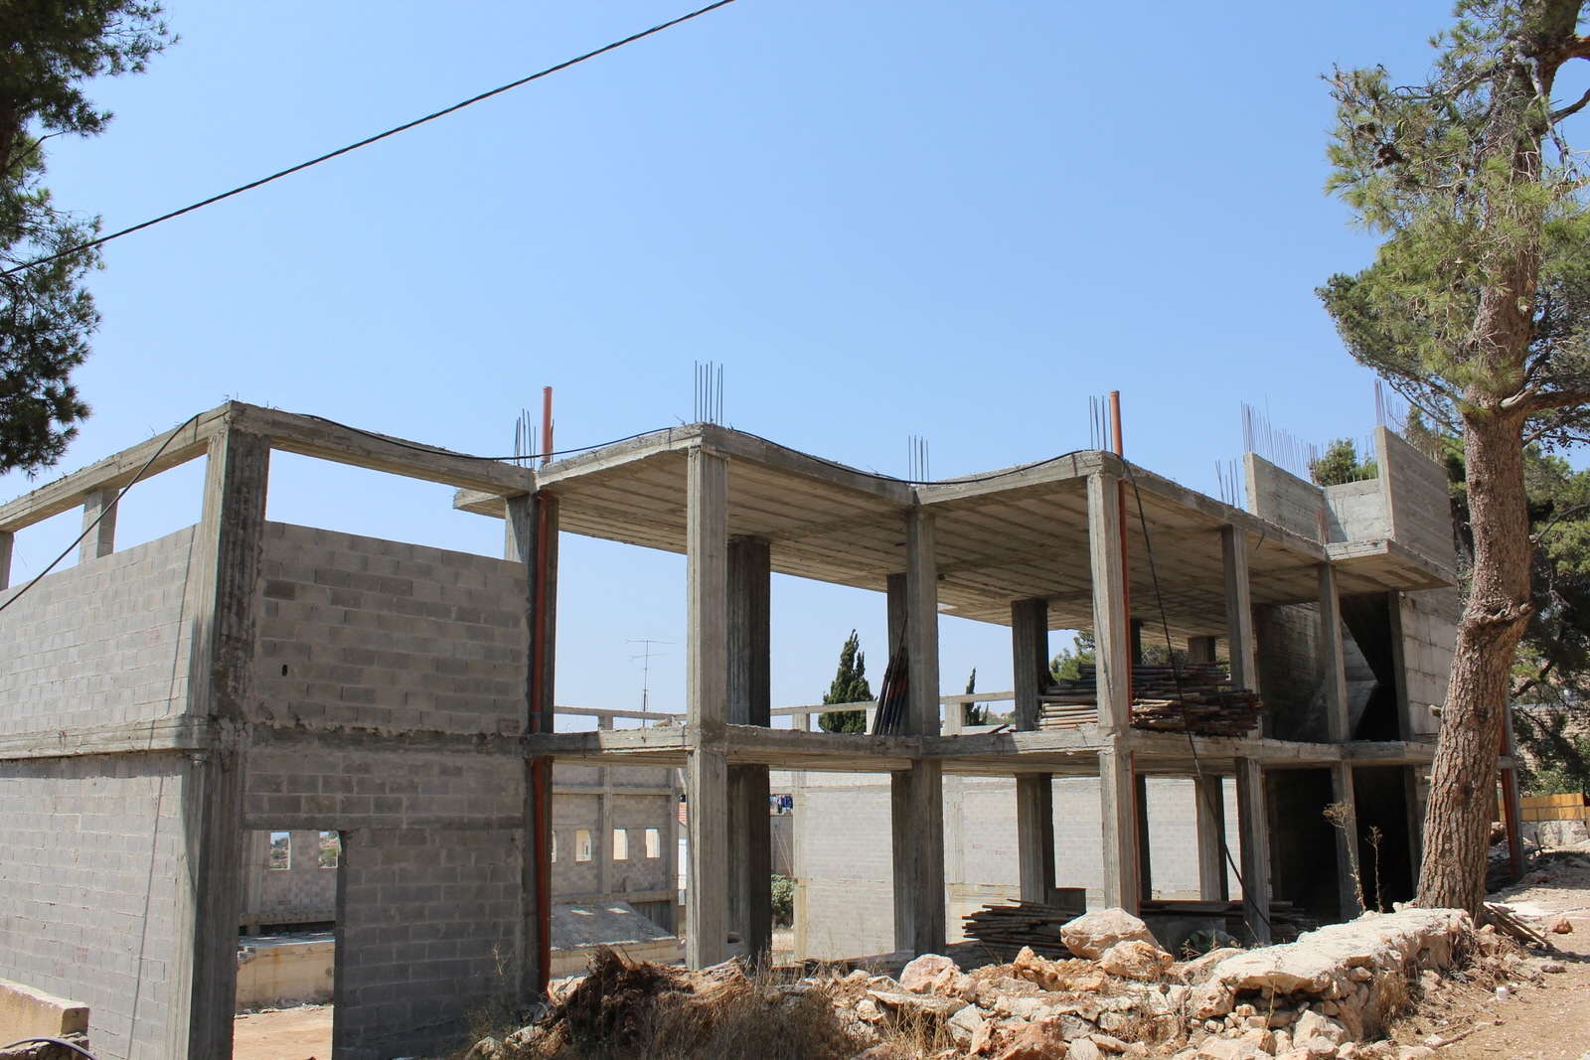
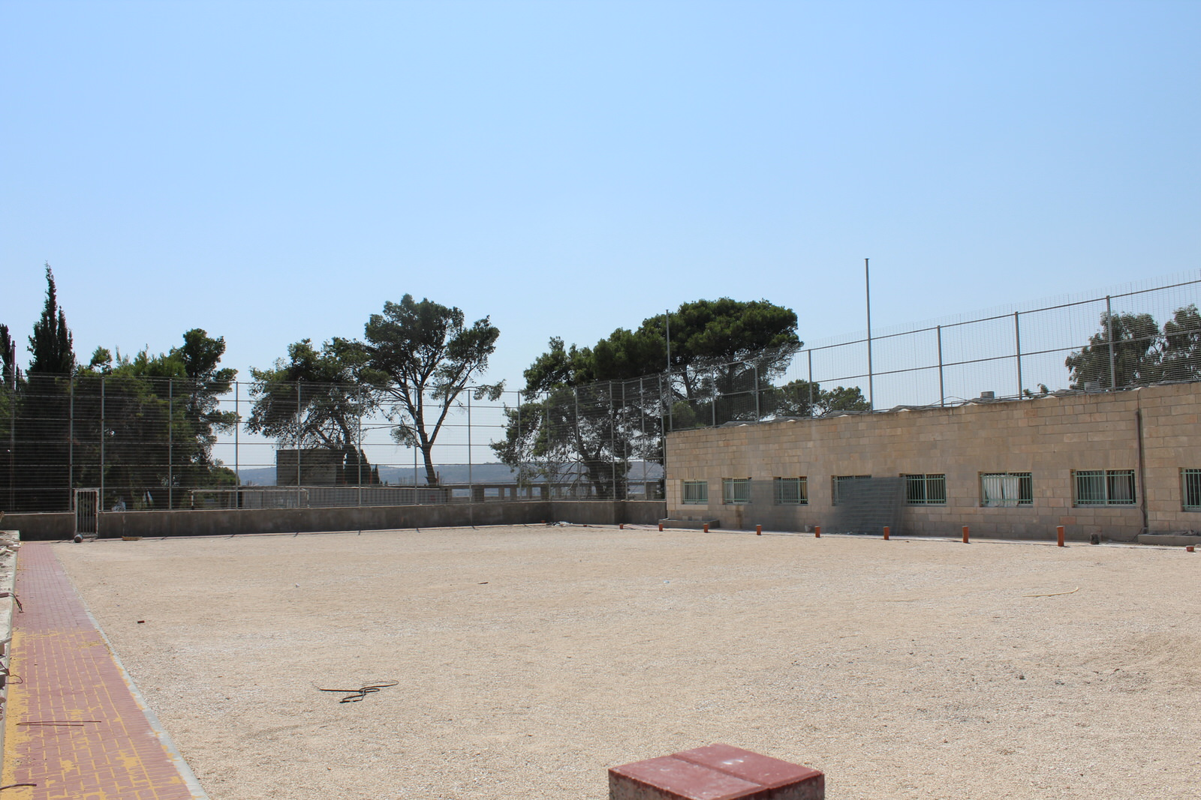
A new basketball court (left) and football/soccer field (below) show Hope’s desire to develop extracurricular opportunities. Upon completion, the playing fields will be used for recess, gym class, organized sports, and school productions and ceremonies. These spaces will also be rented out to sports clubs, which will promote Hope’s standing in the community as well as provide added revenue.

Slide 10
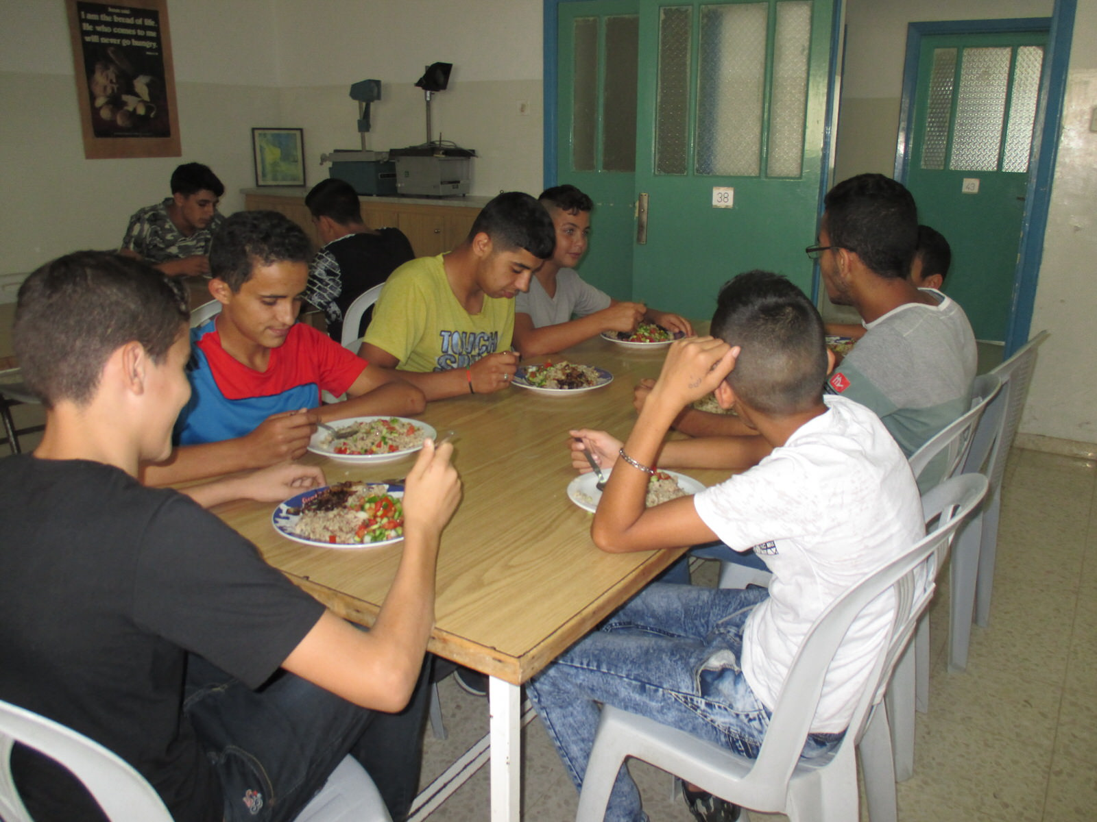
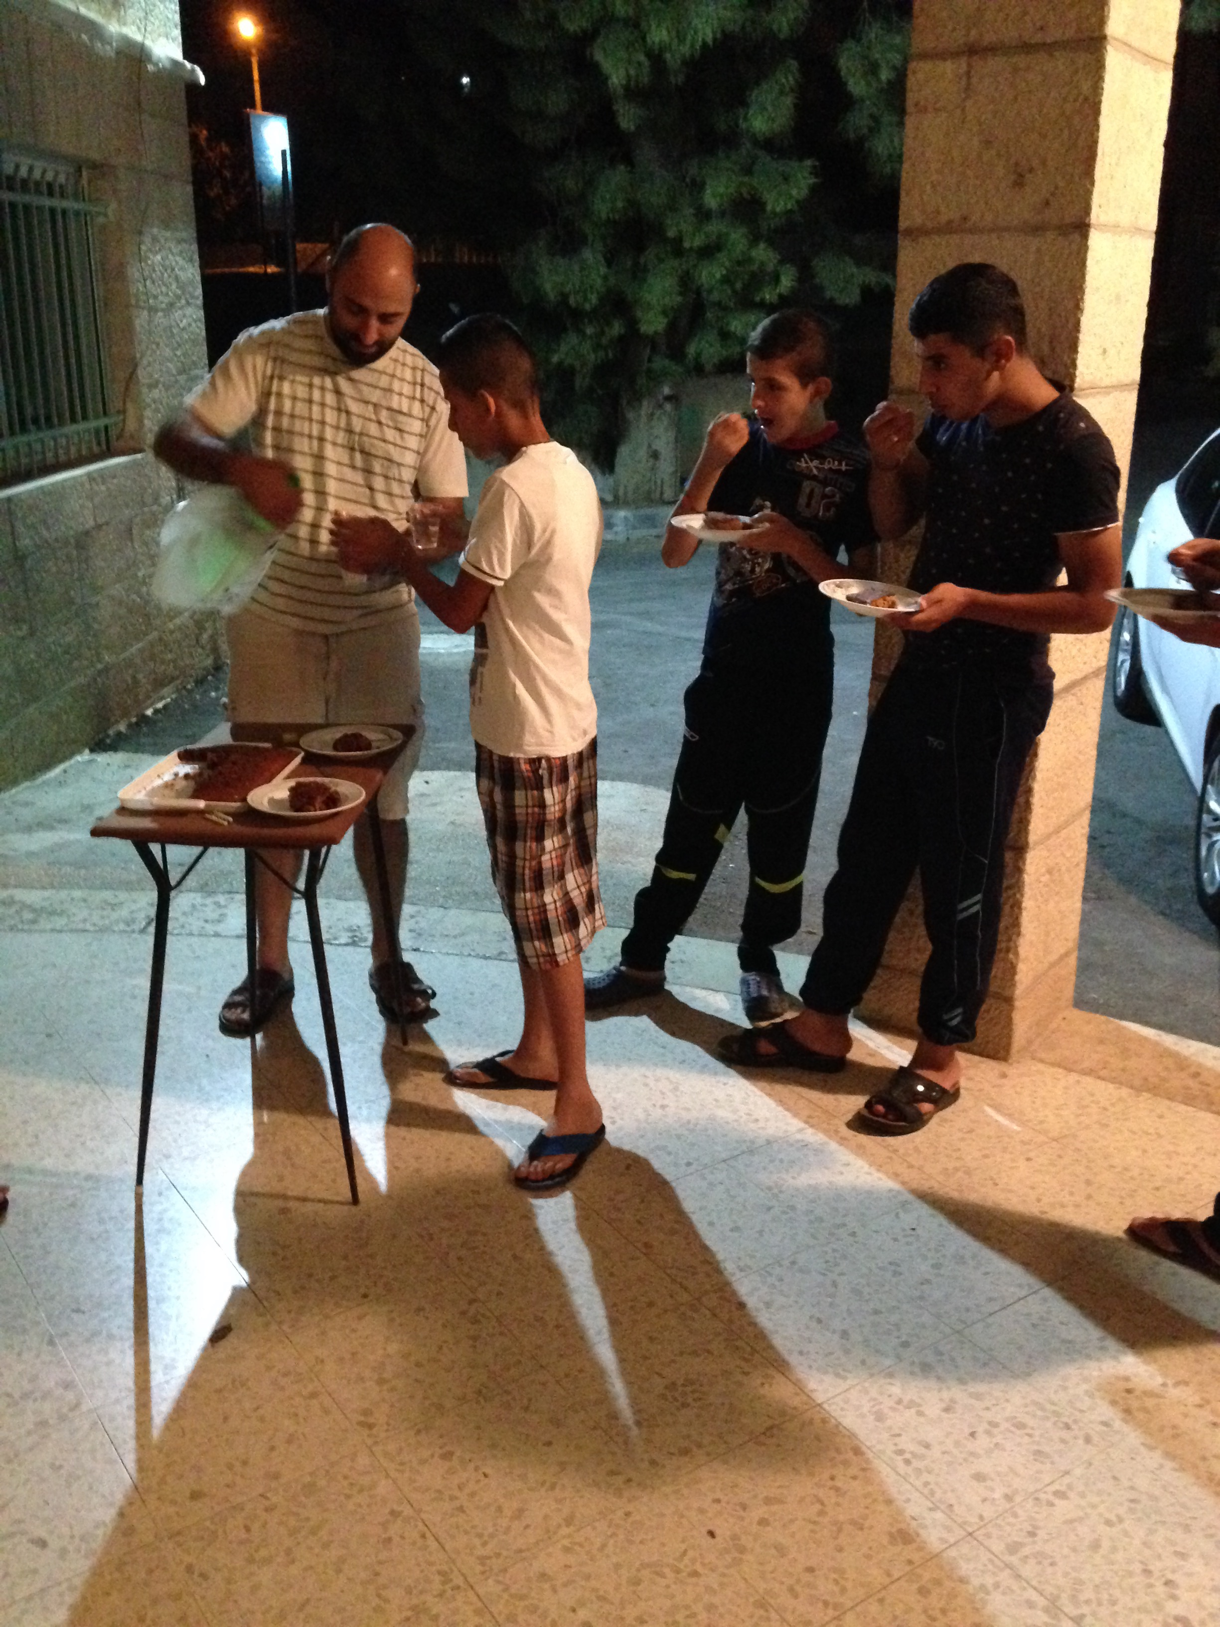
Hope school continues to be a safe haven for its boarding students; these students come to us from broken homes, and some have no home at all. Because the school welcomes these students regardless of how much they are able to pay, the school takes on the burden of their living expenses. Hope is looking for sponsors to help the school cover these costs.

Slide 11
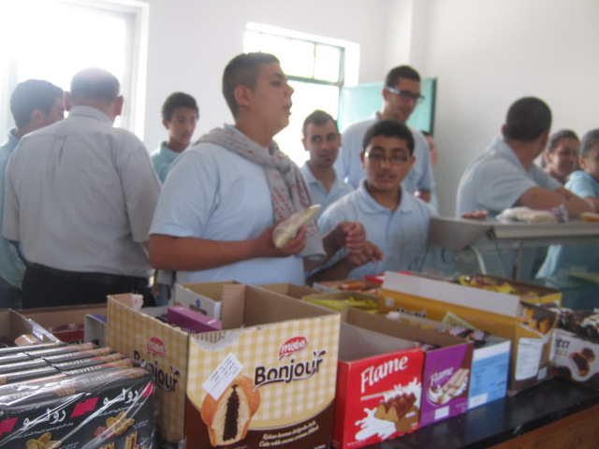
Current Sources of Income
Chicken eggs
Olive wood
Cafeteria
School fees
Donations

Slide 12
While we are very proud of the progress the school has made in recent years, we know there is still plenty of work to be done. Any donations, in part or whole, to the following projects would be greatly appreciated.
Sponsoring day students and boarders (Day: $1,000 US; Boarder: $2,000 US)
Furnishing the kindergarten’s indoor play area ($2,500)
Preparing new classrooms for the growing number of students as we gradually add grades 1-6 ($15,000)
Supplying the chemistry lab with new tools, instruments, and needed supplies ($2,000)
Replacing the out-of-date computers in the computer lab ($16,000)
Rehabilitating the obsolete water pipes to improve water quality and efficiency

Slide 13
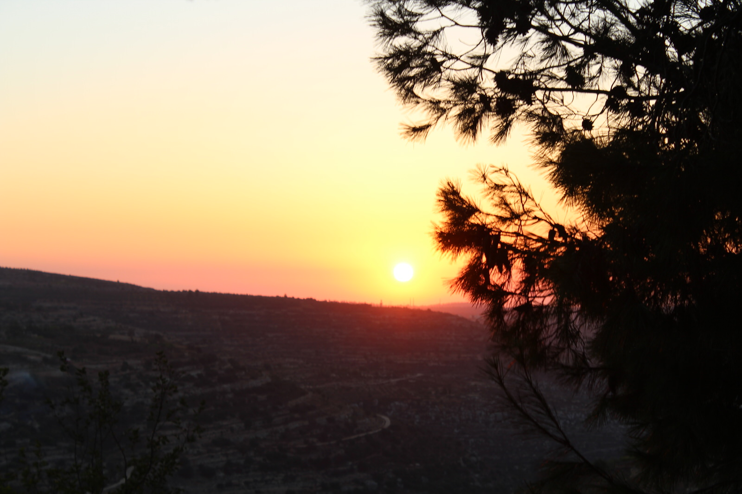
Finally, we ask for your prayers: for completion of our ongoing projects as well as discernment to know what should be done to continue the school’s improvement. Ultimately, we thank you for taking the time to learn about Hope School and the work being done here in the name of Christ.
Contact Us:
info@hopeschoolbeitjala.com
Facebook: Hope Secondary School

